Slide 1
Inheritance, Variation and Evolution
Reproduction and Meiosis
Photo courtesy of Doc. RNDr. Josef Reischig, CSc. (via wikimedia.org) - granted under creative commons licence – attribution

Slide 2
Learning Objective
To explain how gametes are formed.
Targeting Assessment Objective AO1
Success Criteria
To describe the difference between sexual and asexual reproduction.
To discuss the advantages of each type of reproduction.
To explain the difference between mitosis and meiosis.

Slide 3
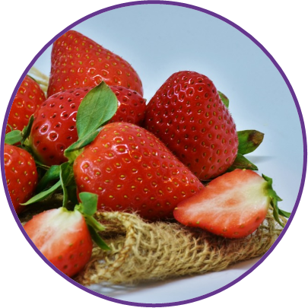

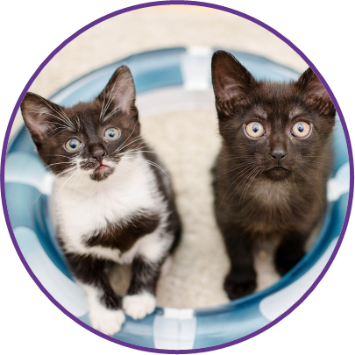
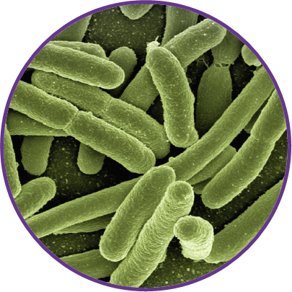
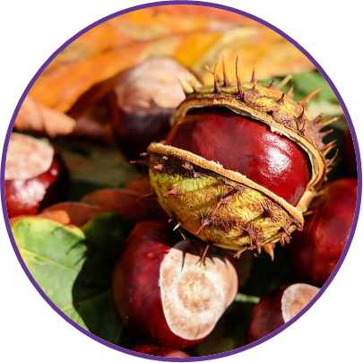
Reproduction
How do these species reproduce?

Slide 4
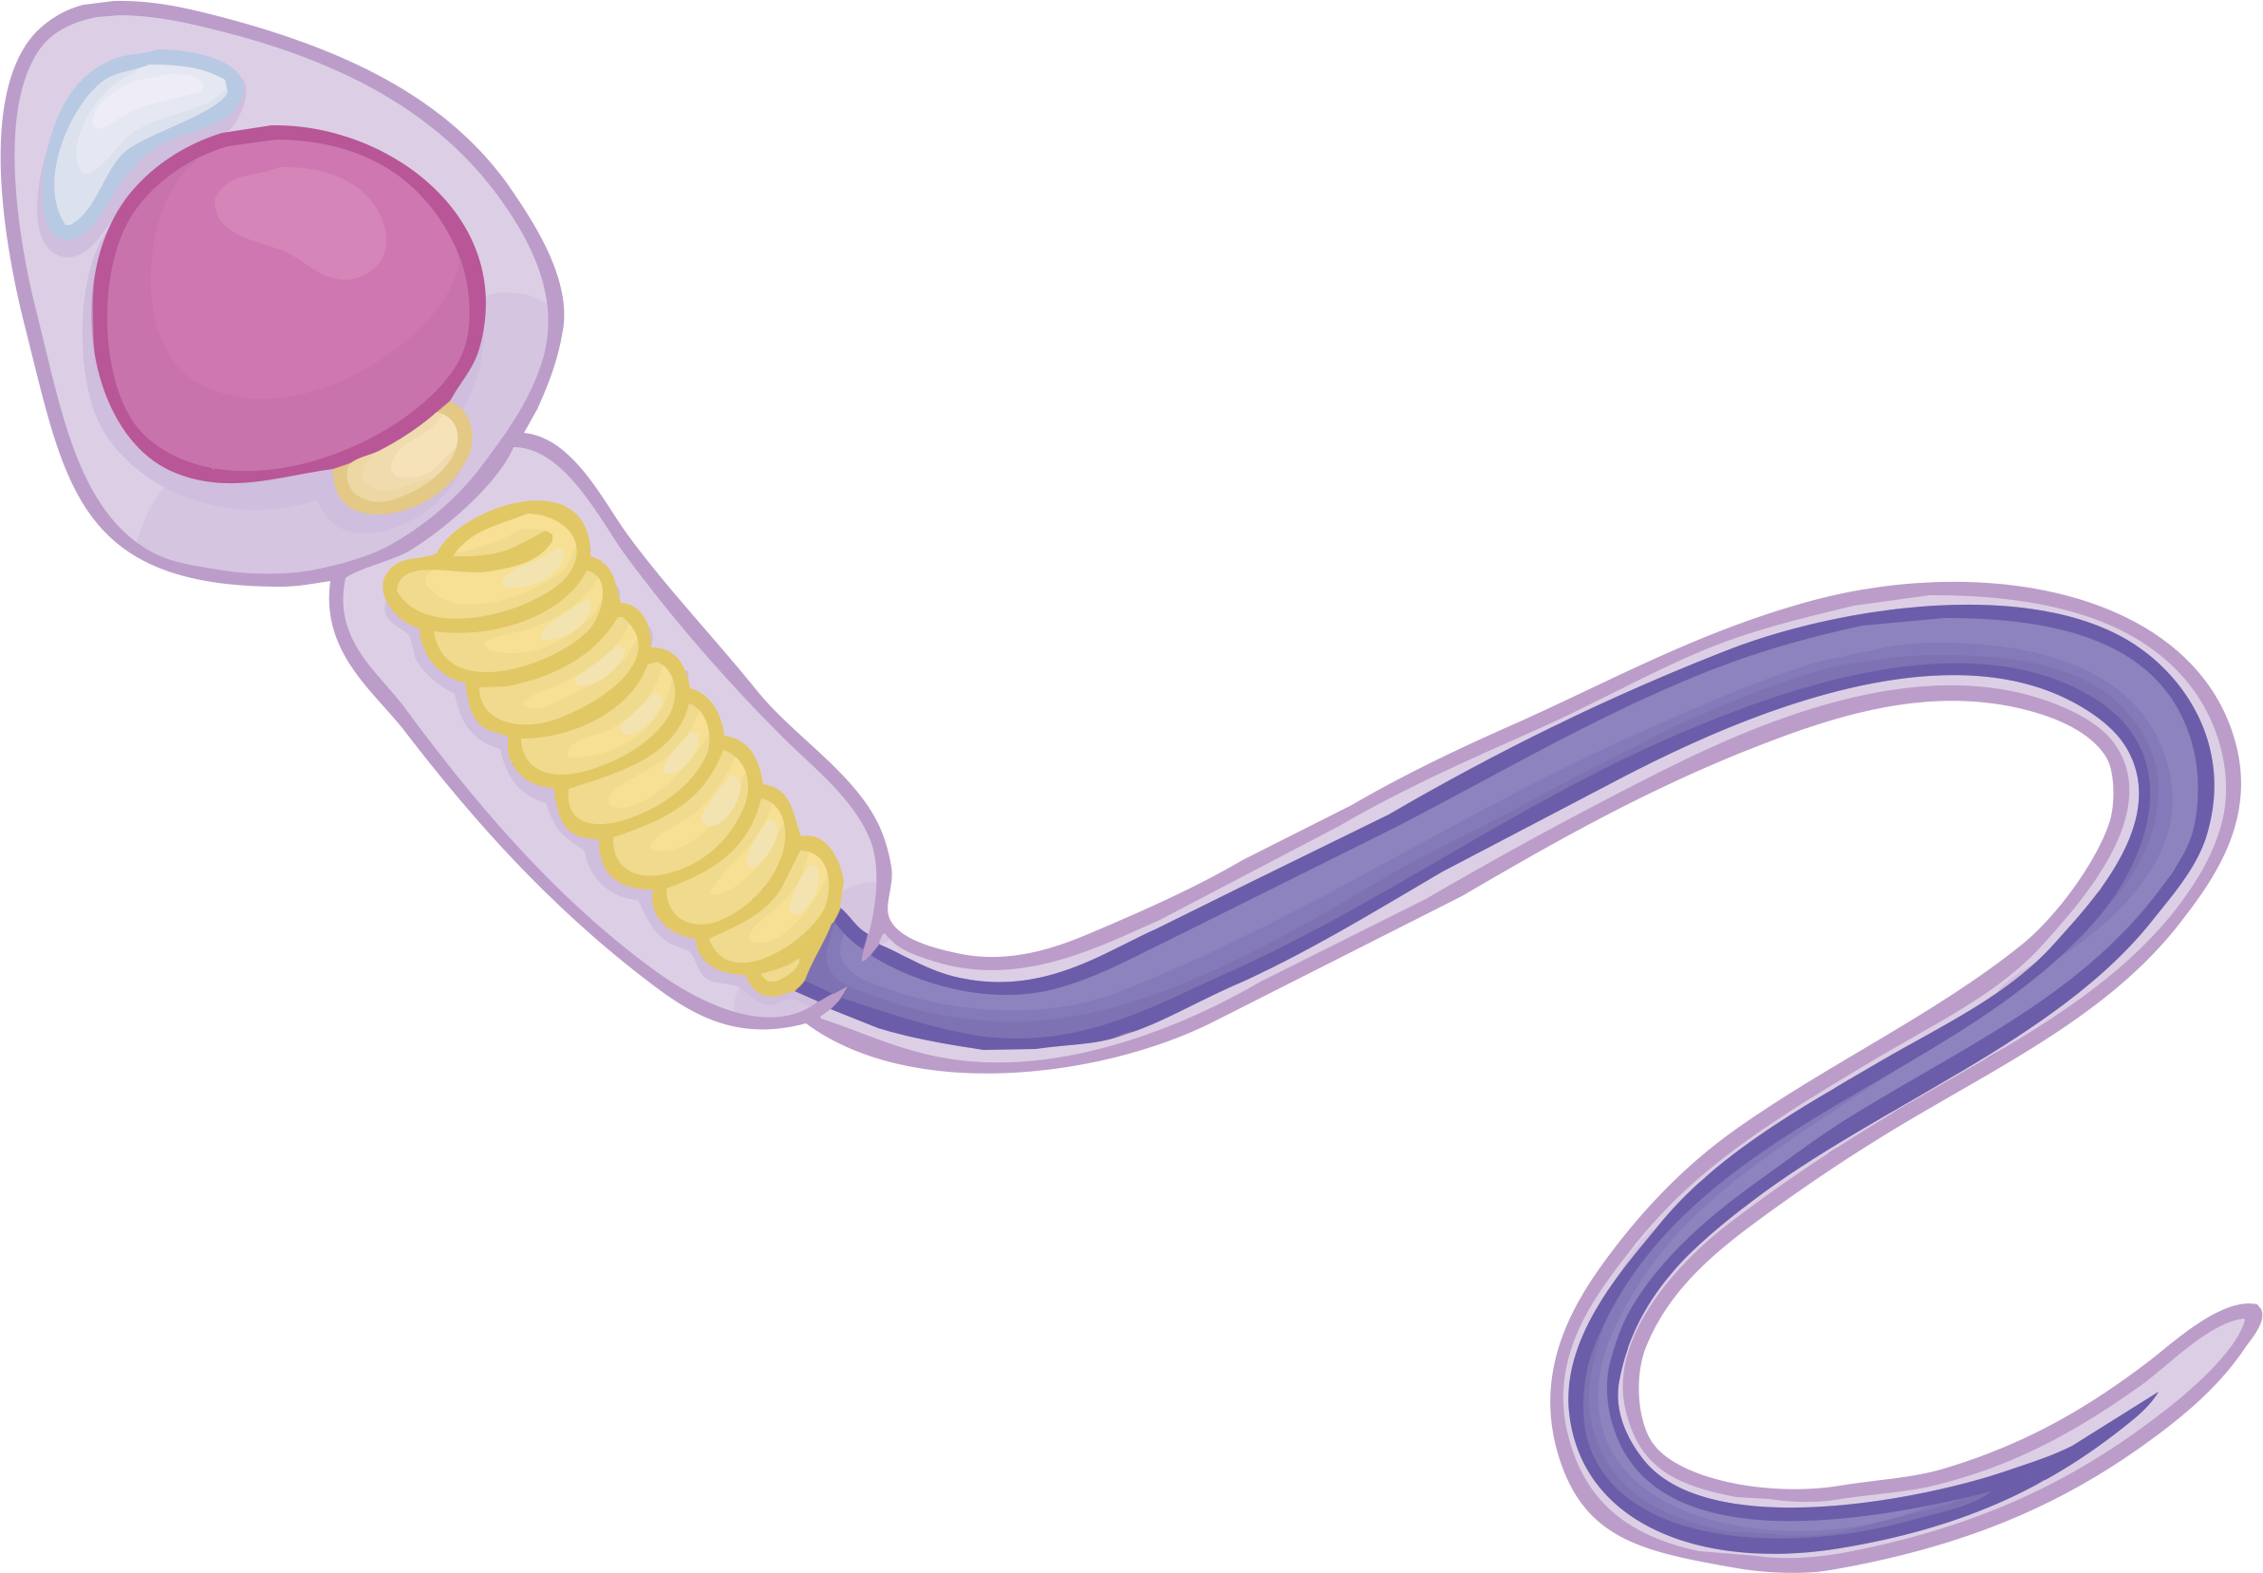
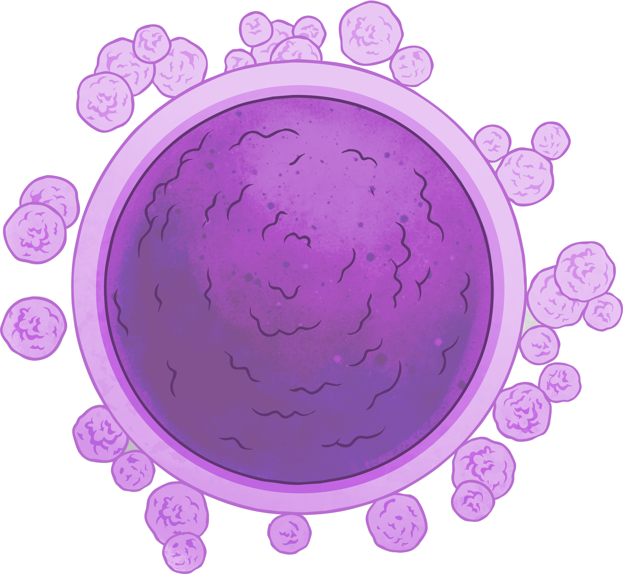

Sexual Reproduction
Sexual reproduction involves a male gamete (sex cell) and a female gamete (sex cell) from two parents.
The gametes are produced by meiosis.
These gametes fuse together in a process called fertilisation.
The genetic information from both gametes is mixed, this leads to variation in the offspring.
In humans, the egg and the sperm each contain 23 chromosomes.
What are the two types of gametes found in animals?
sperm cell
egg cell

Slide 5
Sperm Cell Revision
How is the sperm cell specialised to carry out its function?
The large nucleus contains the genetic information to pass on.
A long tail helps the sperm to move through the female reproductive system to reach the egg.
There are lots of mitochondria to transfer the energy needed for the tail to work.
The acrosome stores enzymes that allow the sperm to break through the egg membrane.

Slide 6


Sexual Reproduction in Plants
The gametes in plants are pollen and egg cells.
The egg cell is found inside the ovary of the flower.
The pollen is produced by the anther.
When pollination occurs, the pollen and the egg cell meet and fuse in fertilisation.
The genetic information from both gametes is mixed. This leads to variation in the offspring.
The fertilised cell forms seeds.
ovary
anther

Slide 7
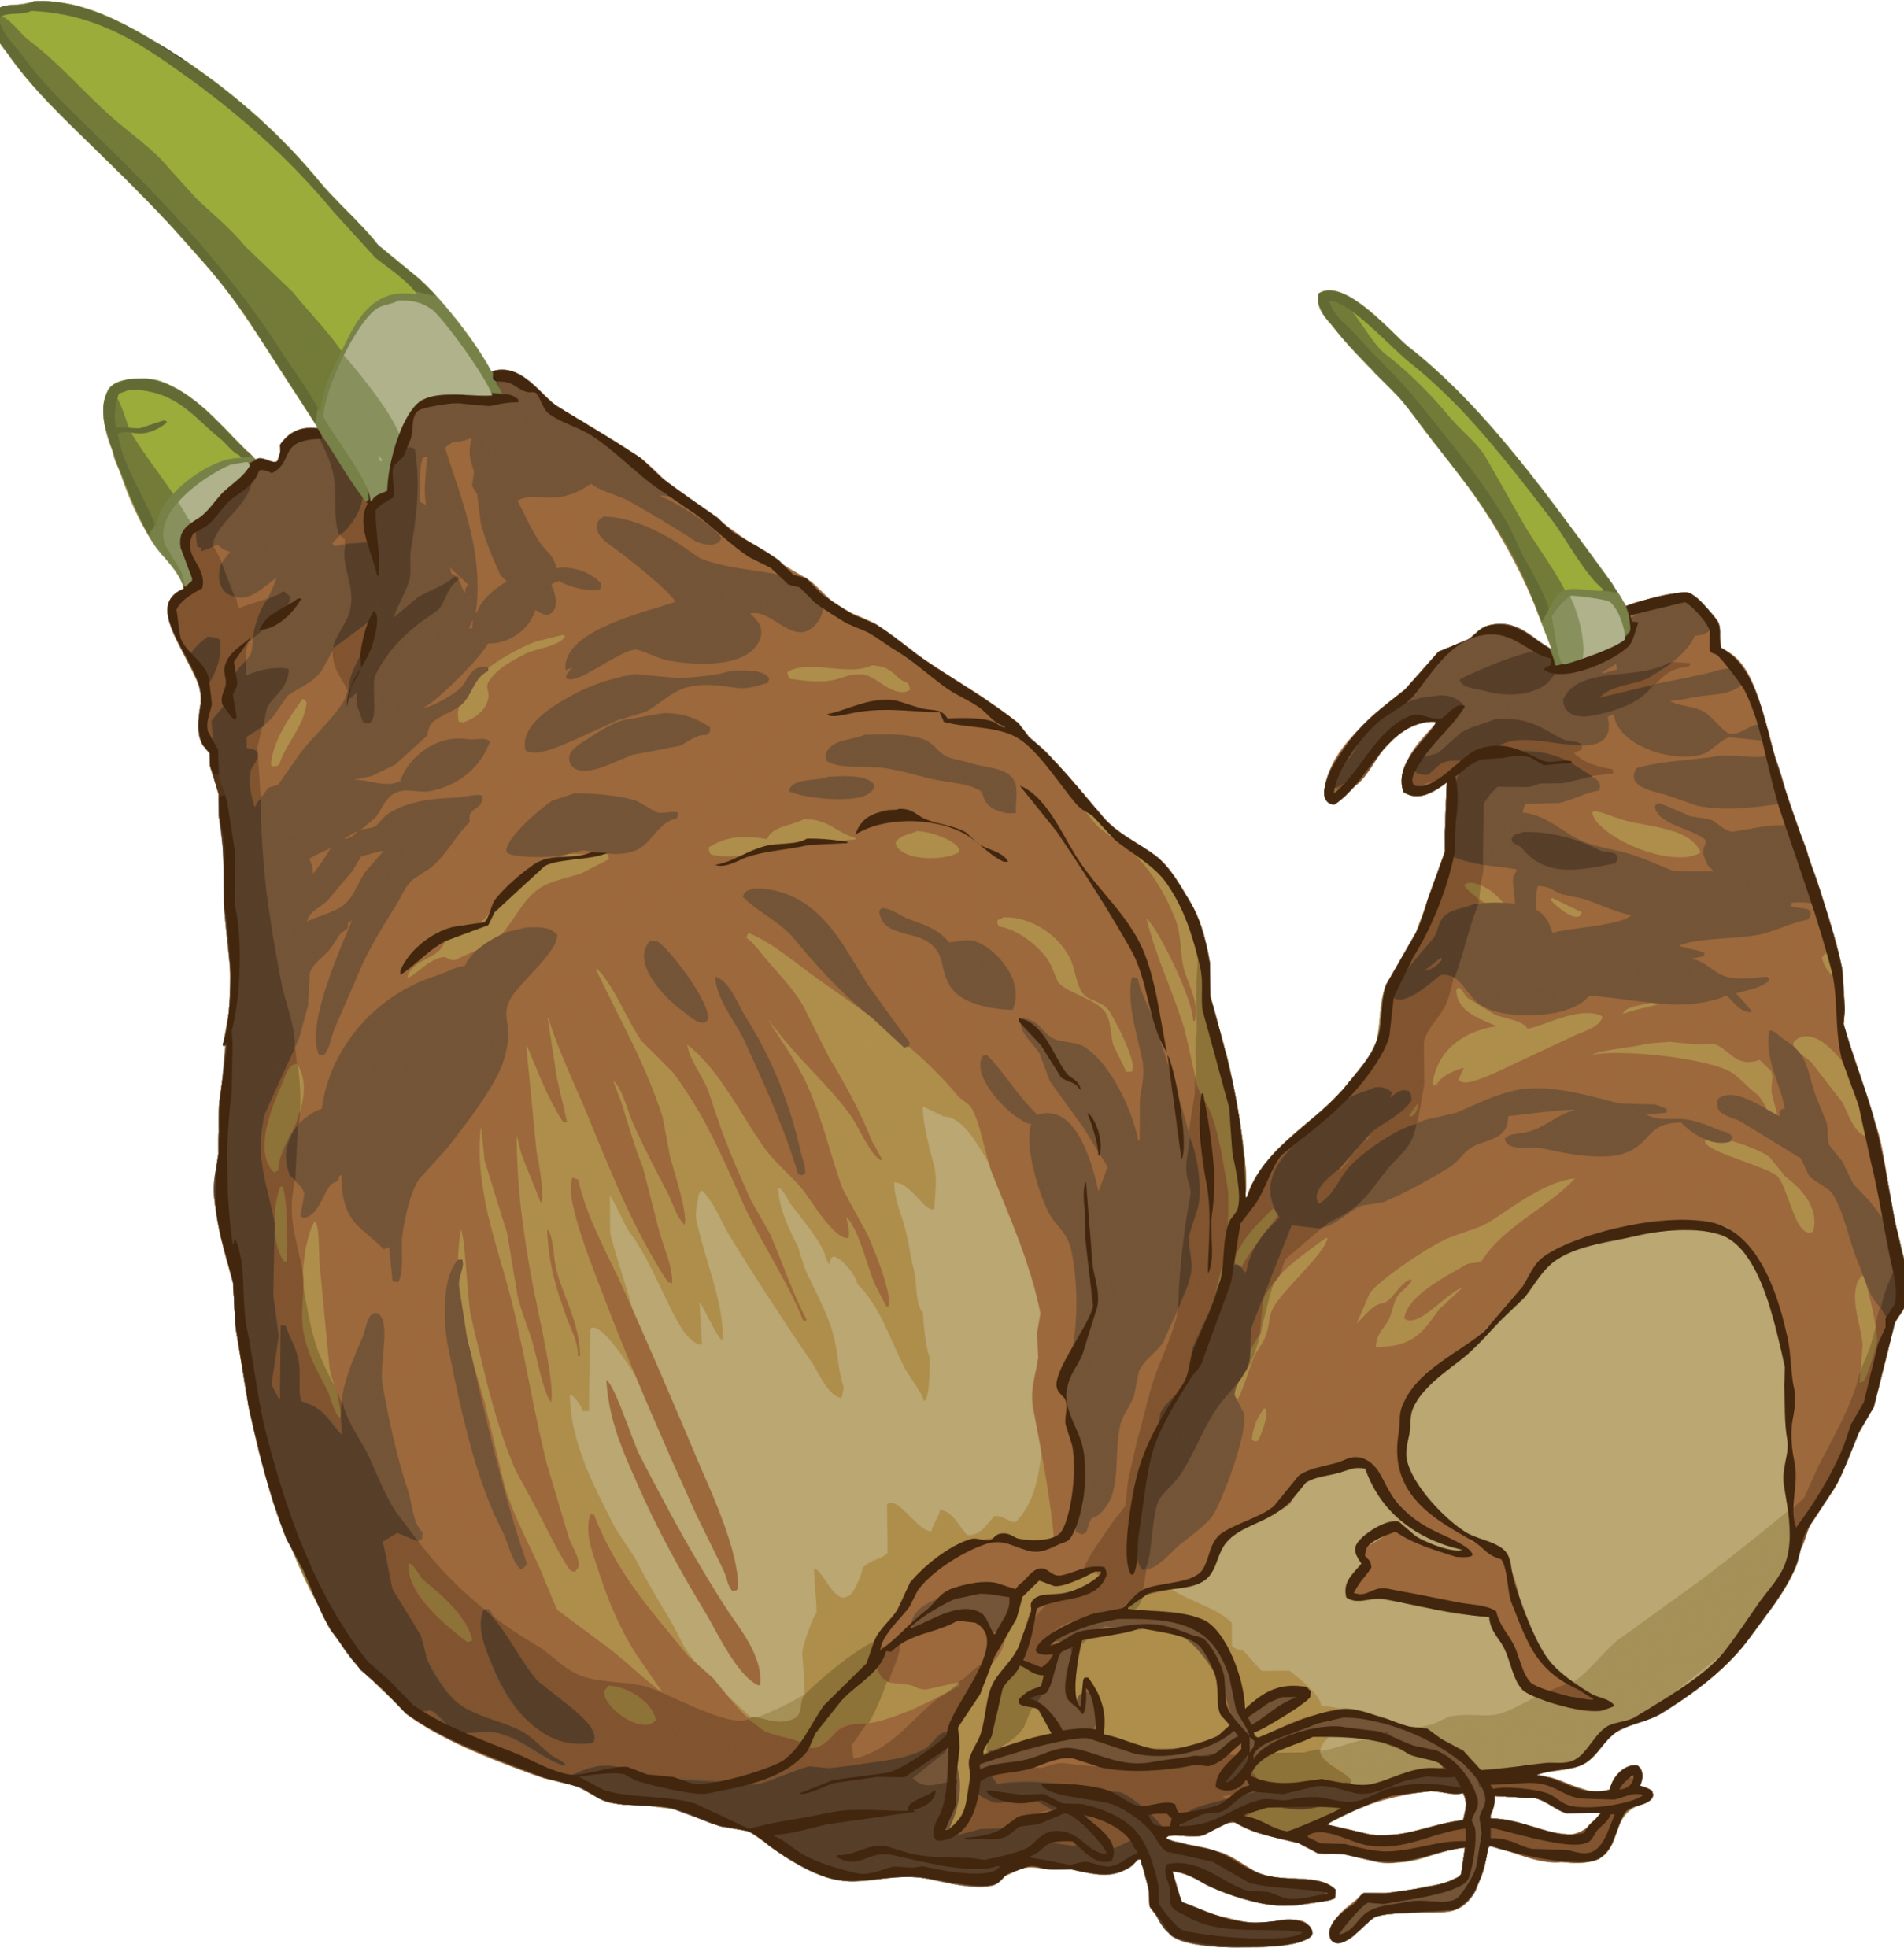
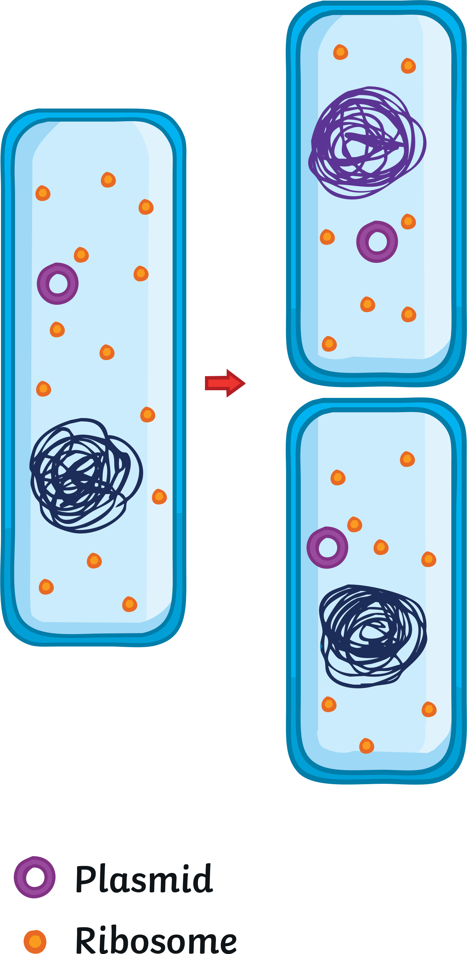
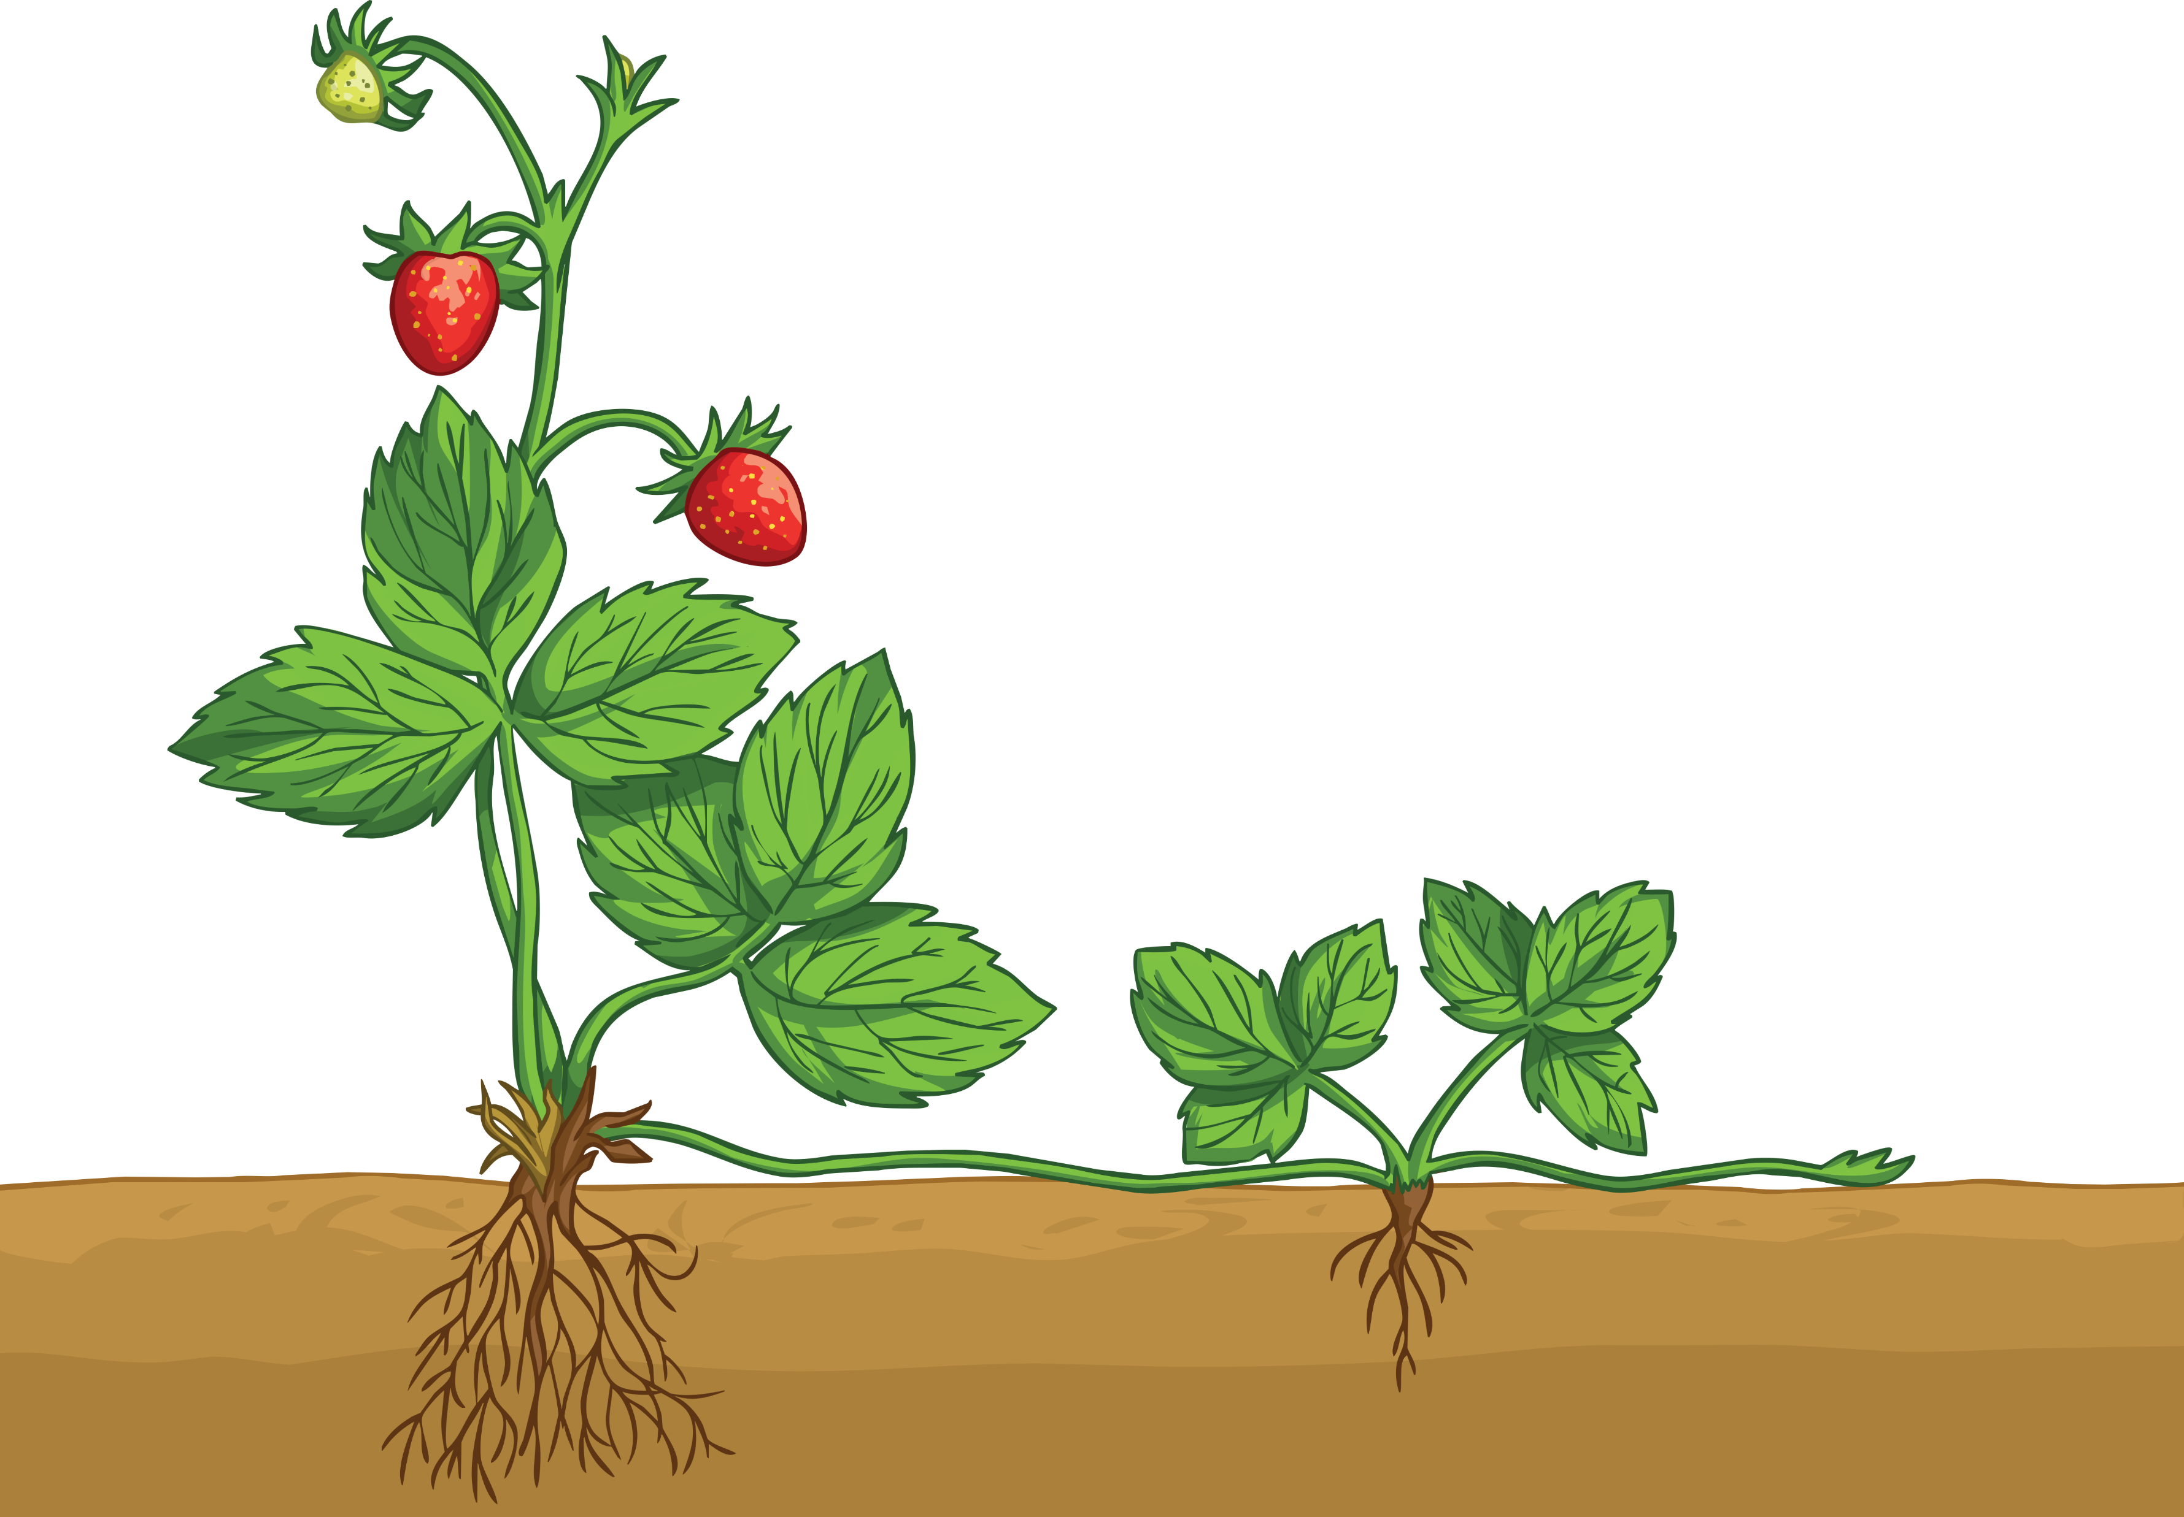
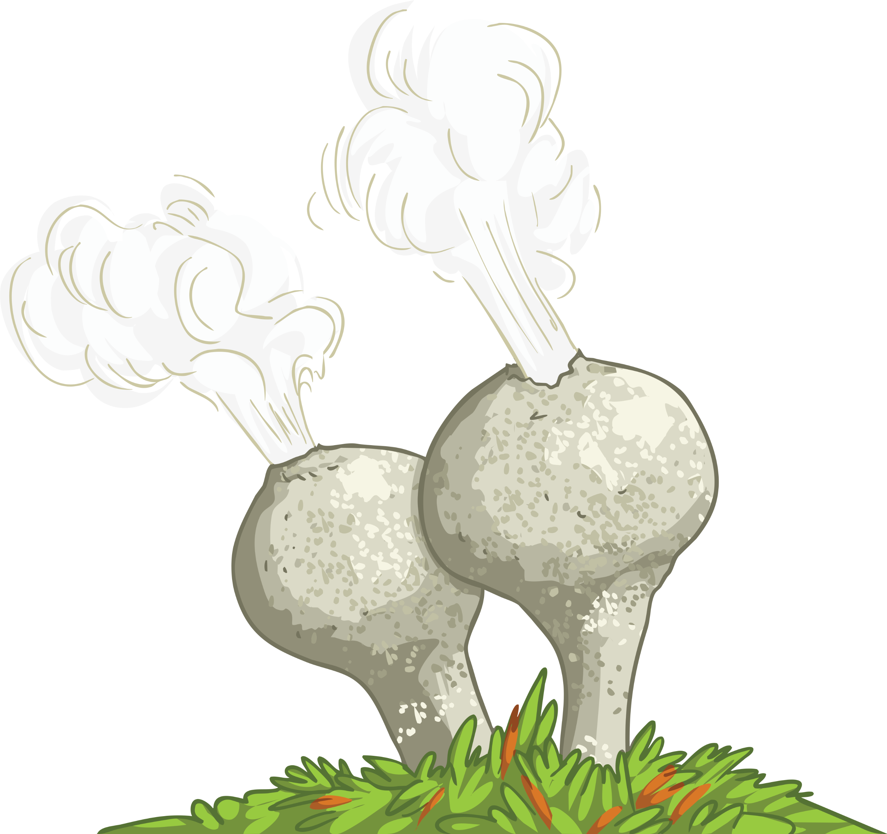
Asexual Reproduction
It involves only one parent.
There is no fusion of gametes, therefore there is no mixing of genetic information.
It produces genetically identical offspring (clones).
Only mitosis is involved.
mother plant
stolon or runner
new plant

Slide 8

Advantages of Reproduction Types
Which type of reproduction do you think would be the most
useful in each situation?
I am a single-celled organism living in a vast stable environment.
I live in an environment that changes often.
I have been living in favourable conditions for a long time without much change to my environment. I am well adapted to this environment.
I am a crop on a farm. The farmer needs me to be the best
I can be.

Slide 9

Advantages of Reproduction Types
Sexual Reproduction
Asexual Reproduction
Produces variation in the offspring.
If the environment changes, variation gives a survival advantage by natural selection.
Natural selection can be sped up by humans in selective breeding to increase food production.
Only one parent needed.
More time and energy efficient as they do not need to find a mate.
Faster than sexual reproduction.
Many identical offspring can be produced when conditions are favourable.

Slide 10
Advantages of Reproduction Types
Which type of reproduction do you think would be the most
useful in each situation?
I am a single-celled organism living in a vast stable environment.
I live in an environment that changes often.
I have been living in favourable conditions for a long time without much change to my environment. I am well adapted to this environment.
I am a crop on a farm. The farmer needs me to be the best
I can be.

Slide 11
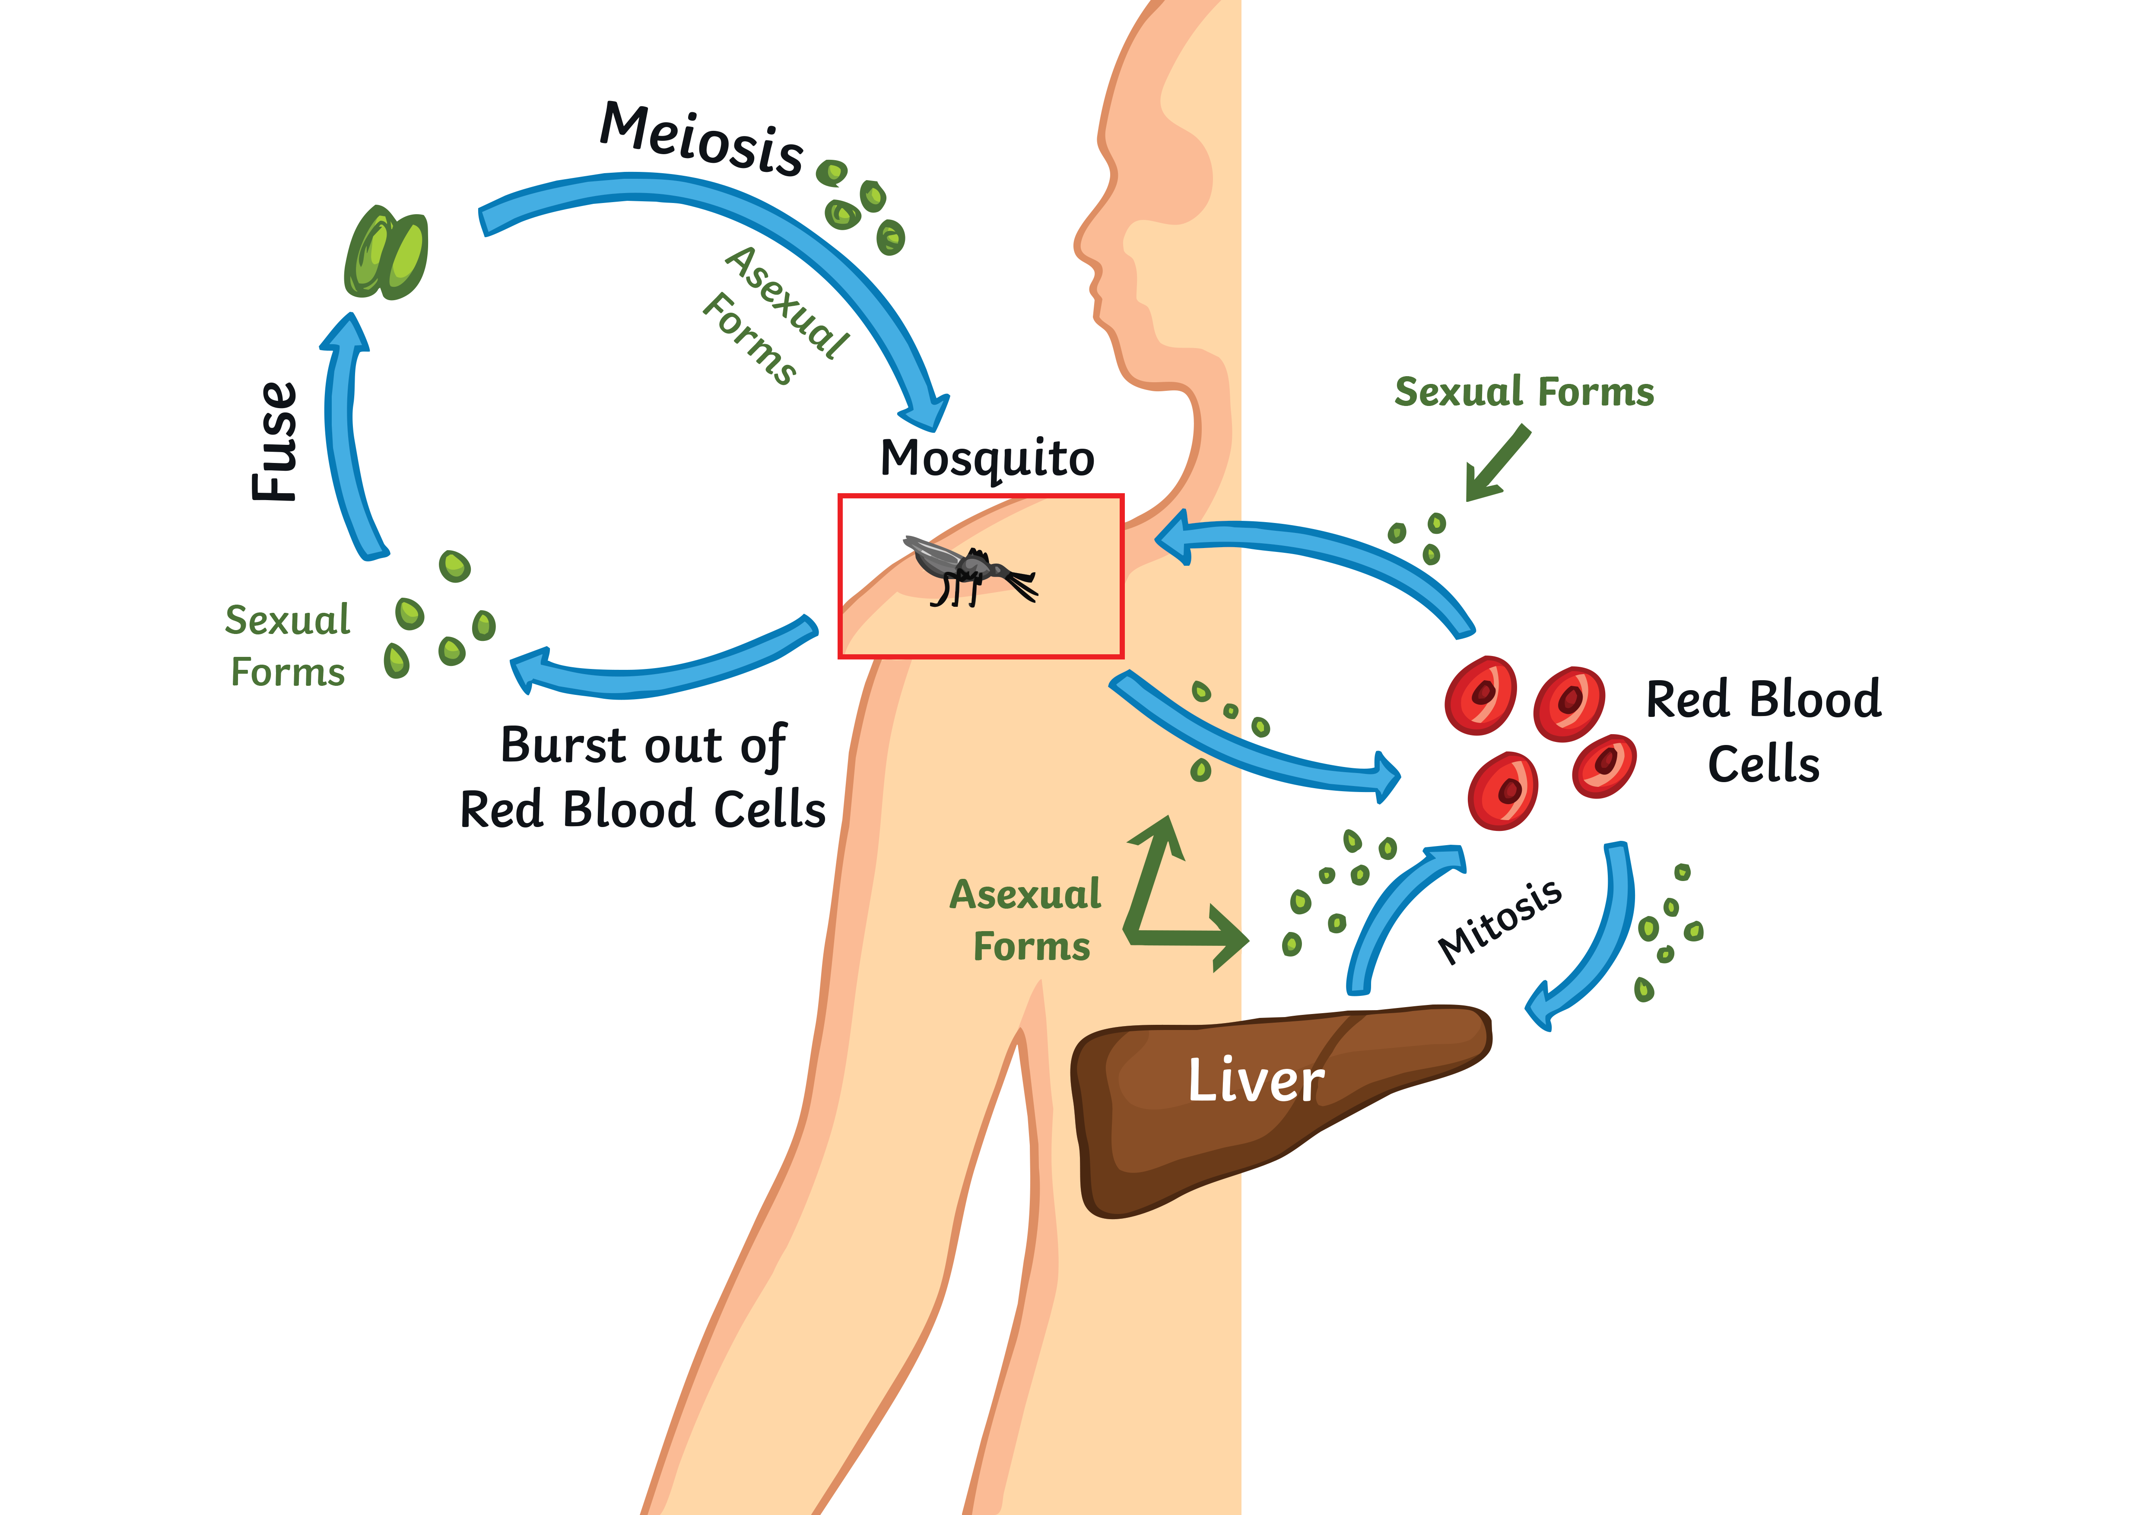
The Best of Both Worlds: Malaria
Malarial parasites spend part of their lifecycle in a mosquito (the vector) and part of it in a human body.
The female mosquito drinks human blood. When it feeds, it releases the malarial parasite into the human blood stream.
The parasites reproduce asexually in
human blood and liver cells.
When the mosquito feeds, it takes in red blood cells containing the parasite.
The drop in temperature between the human and mosquito causes sexual forms to burst out of the red blood cells and fuse together.
These then undergo meiosis to produce new asexual parasites that will infect a new human when the mosquito feeds.

Slide 12



The Best of Both Worlds: Fungi
Many fungi reproduce asexually. They form spores by mitosis that are genetically identical to the parent.
Some fungi also reproduce sexually if the conditions are not good. This introduces some variation.
Hyphae extend between two fungi and fuse to form cells with two sets of chromosomes. It then makes spores by meiosis that have a mix of genetic variation.
Pause for Thought
Why do they carry out sexual
reproduction when the conditions
are not favourable?

Slide 13

The Best of Both Worlds: Plants
Most plant reproduction is sexual. The pollen from one flower must reach the female parts in another flower for the pollen and the egg to fuse. Once this has happened, seeds are formed.
Many plants can also reproduce
asexually, if needed.
Strawberry plants send out runners and
daffodil bulbs divide to form identical
new plants.
How are flowers adapted for pollination
to occur?
Why might they need to do this?
mother plant
stolon or runner
new plant
What is the disadvantage of the plants reproducing asexually?

Slide 14
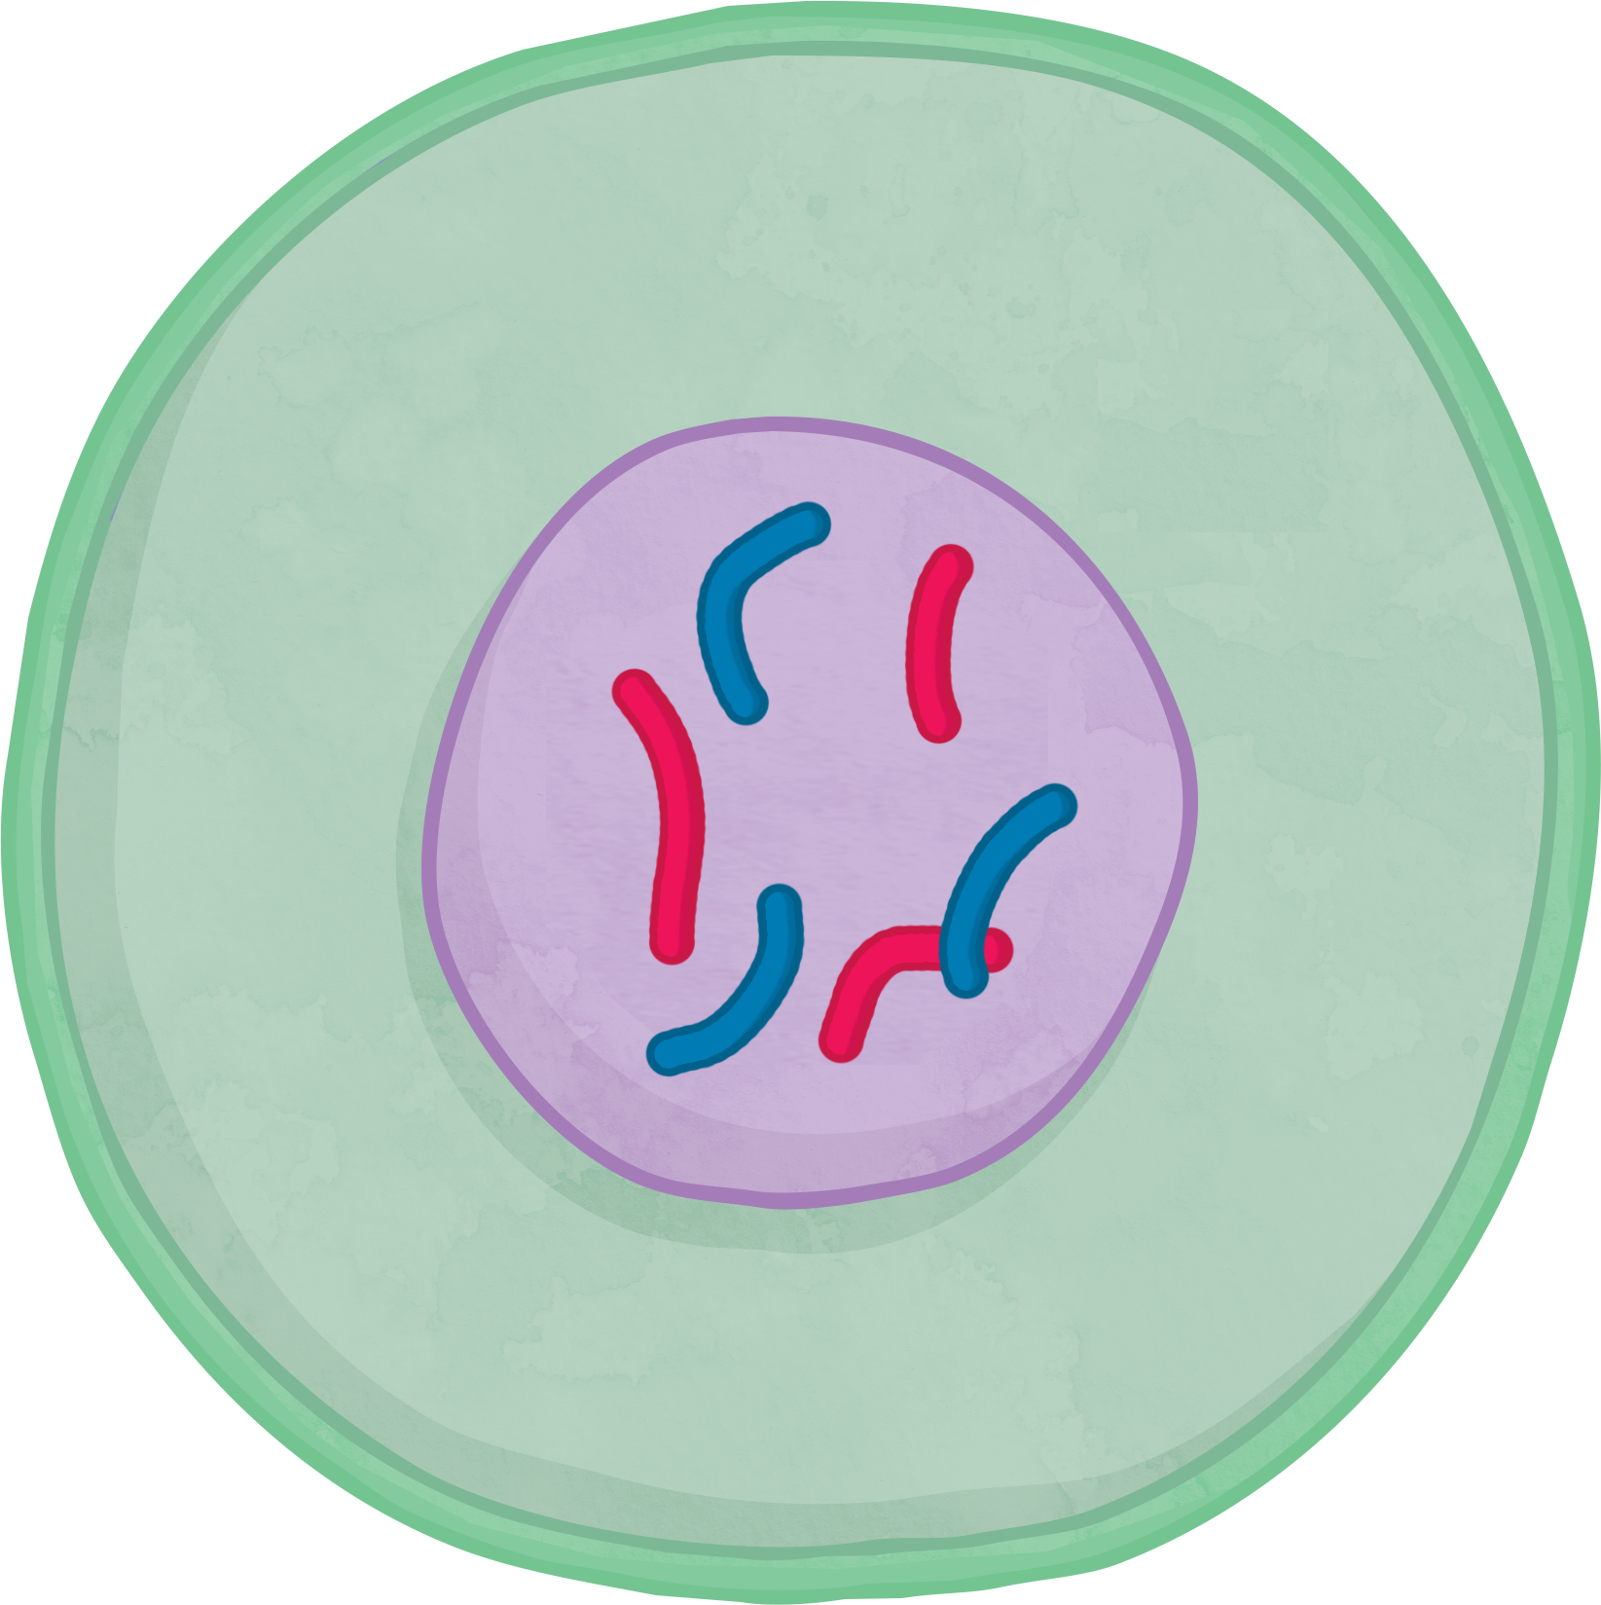
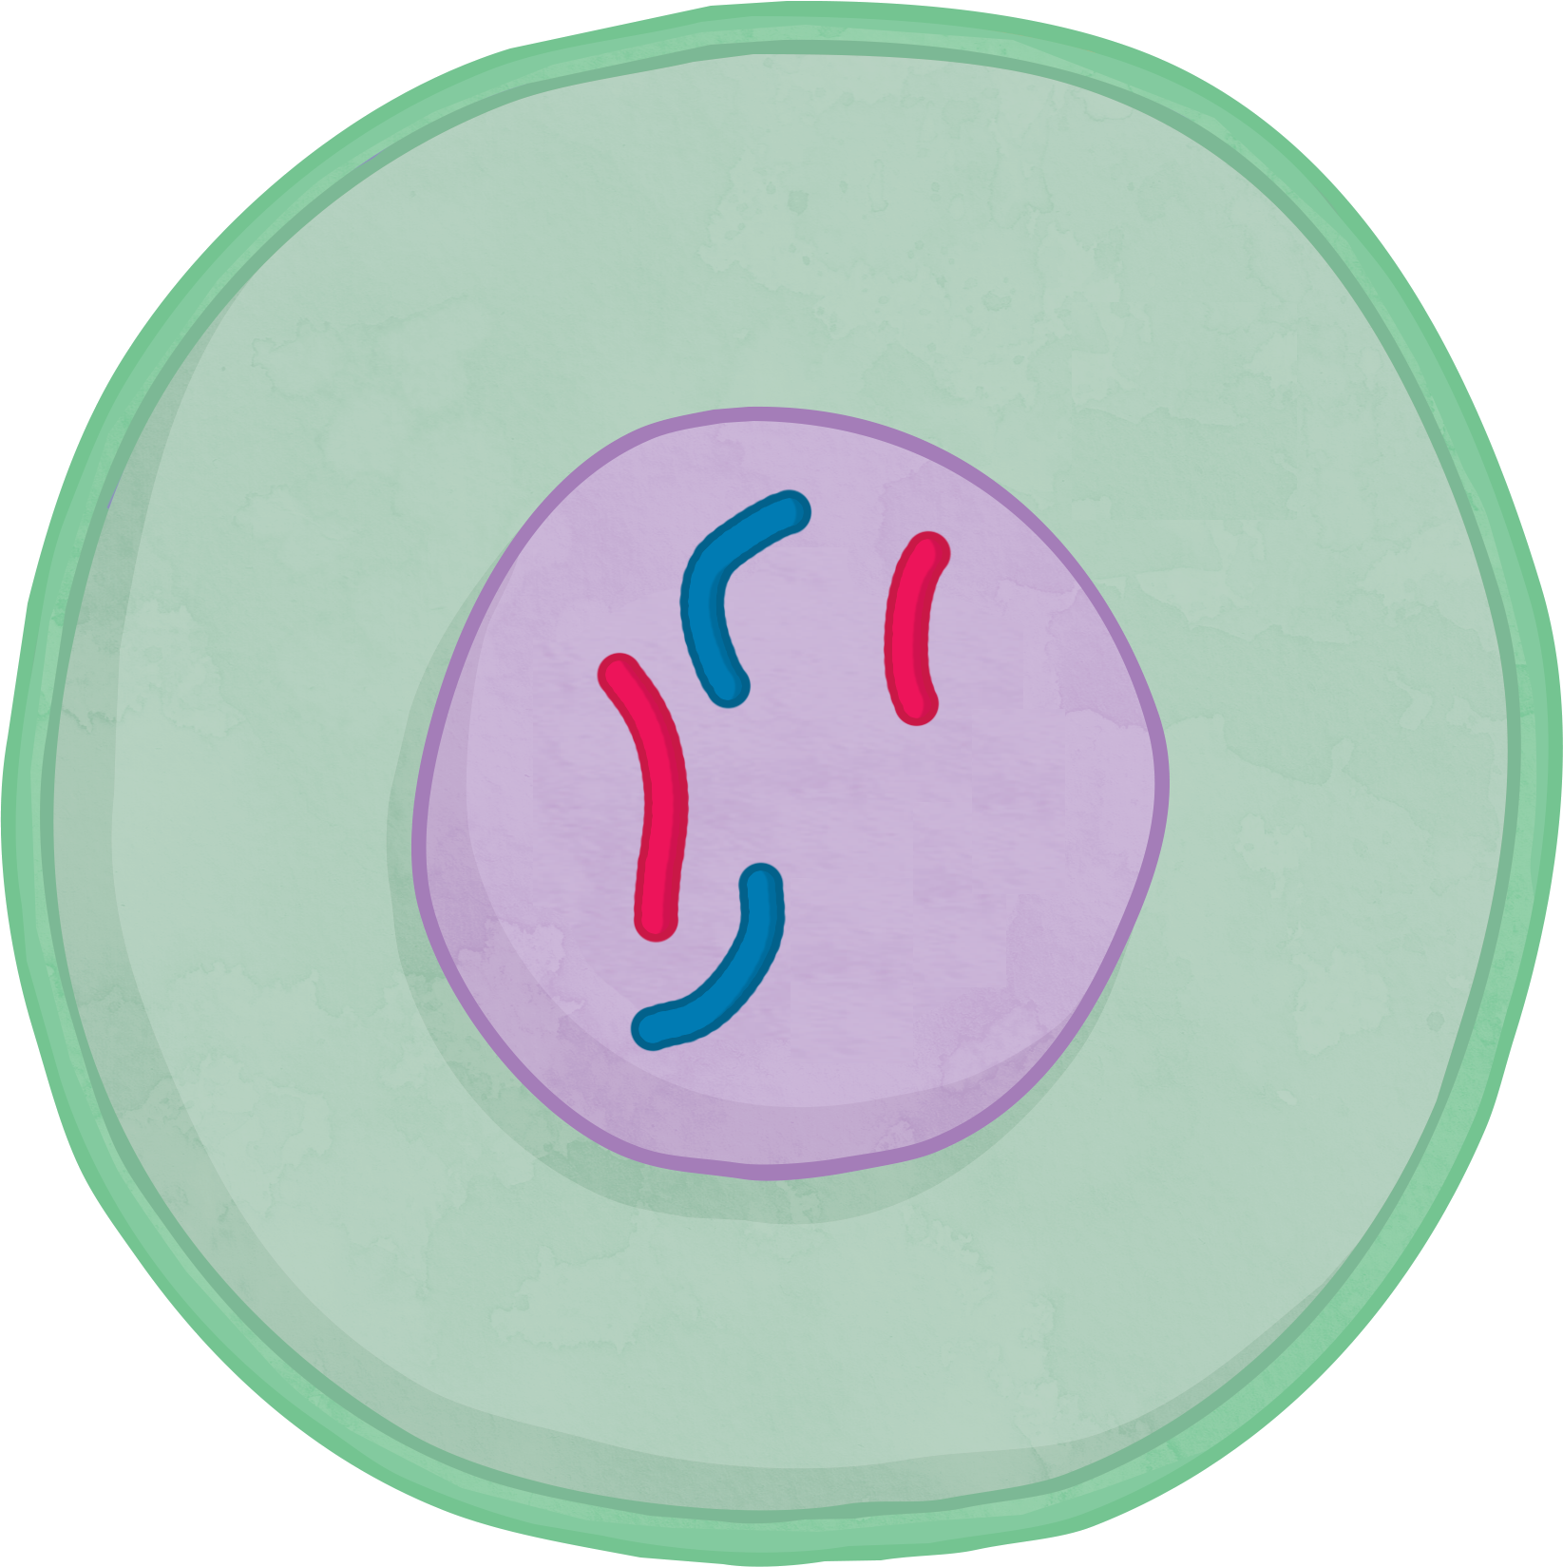
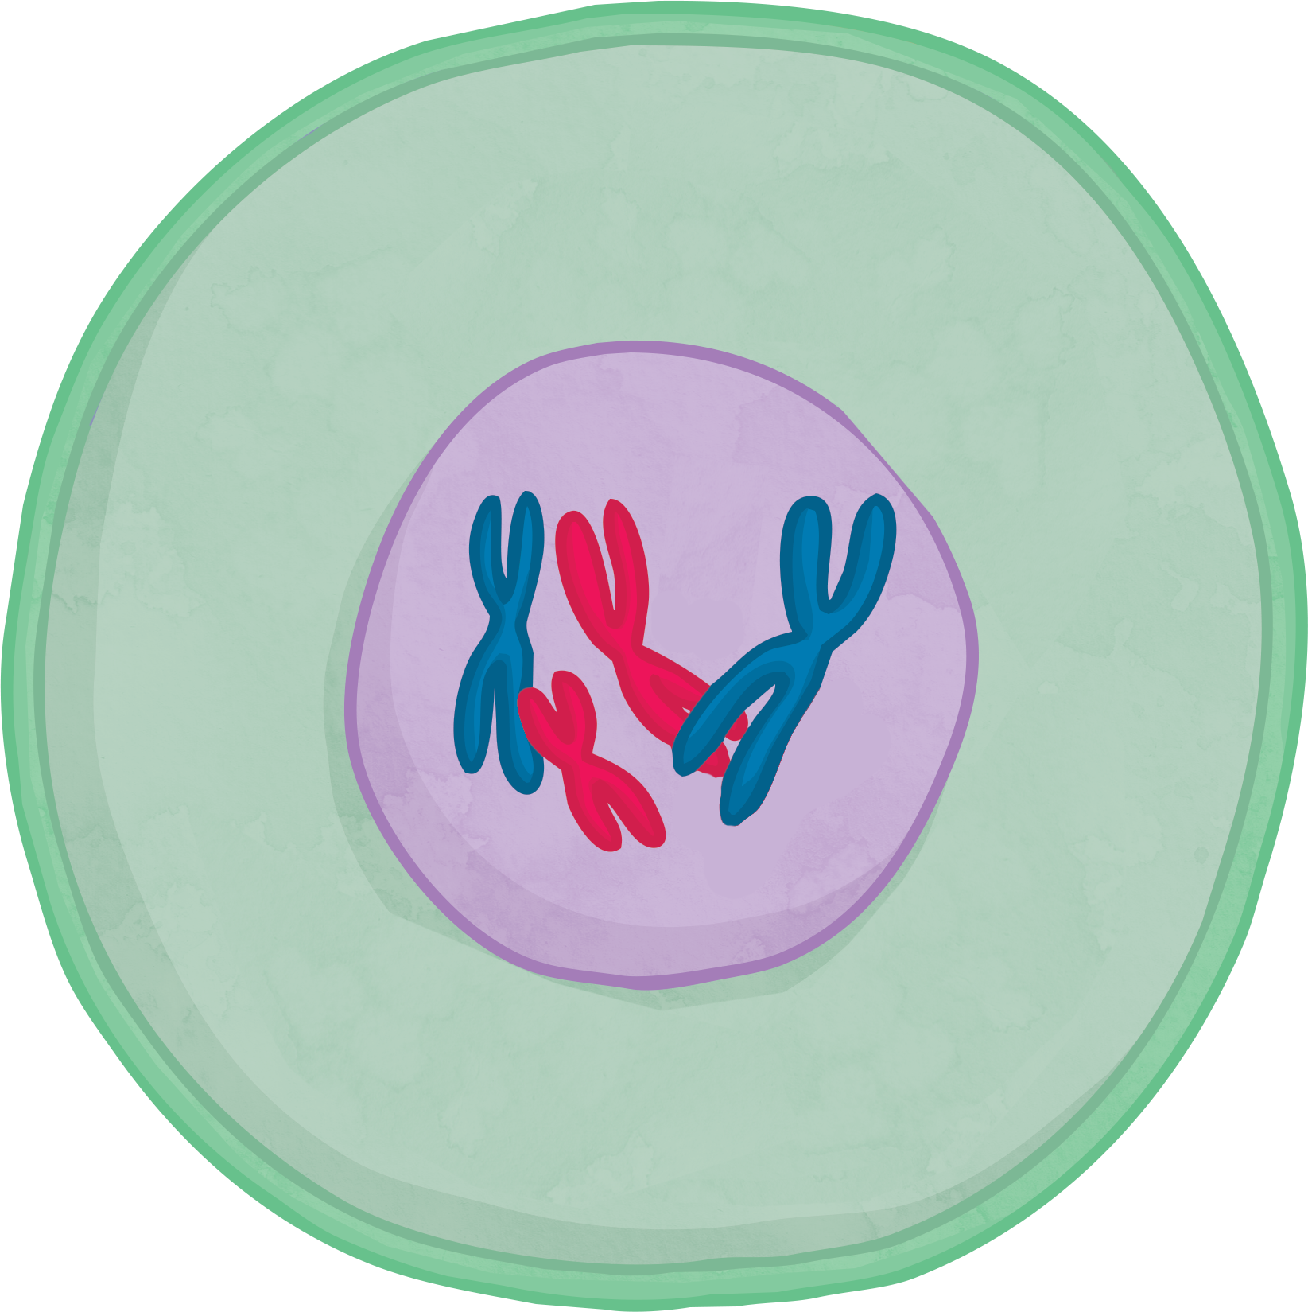
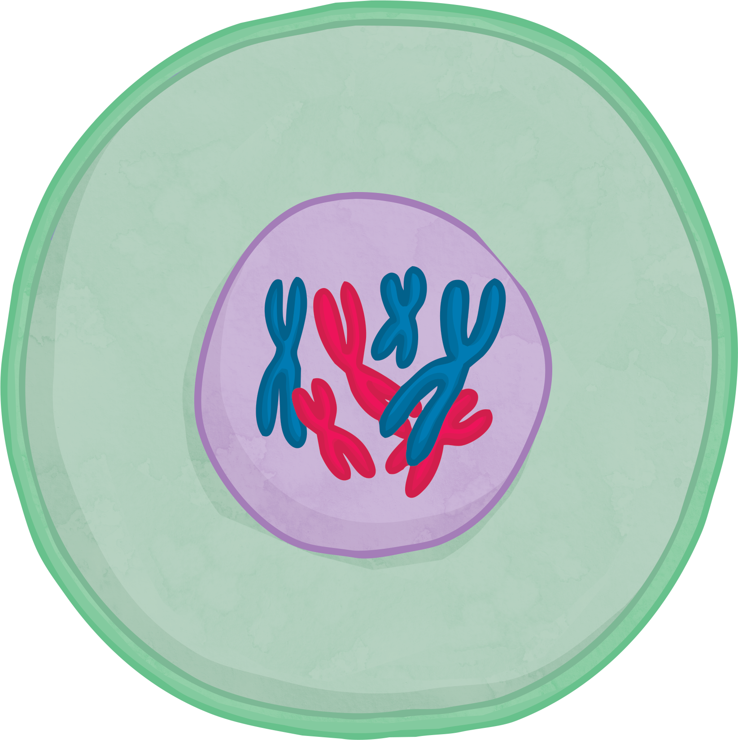
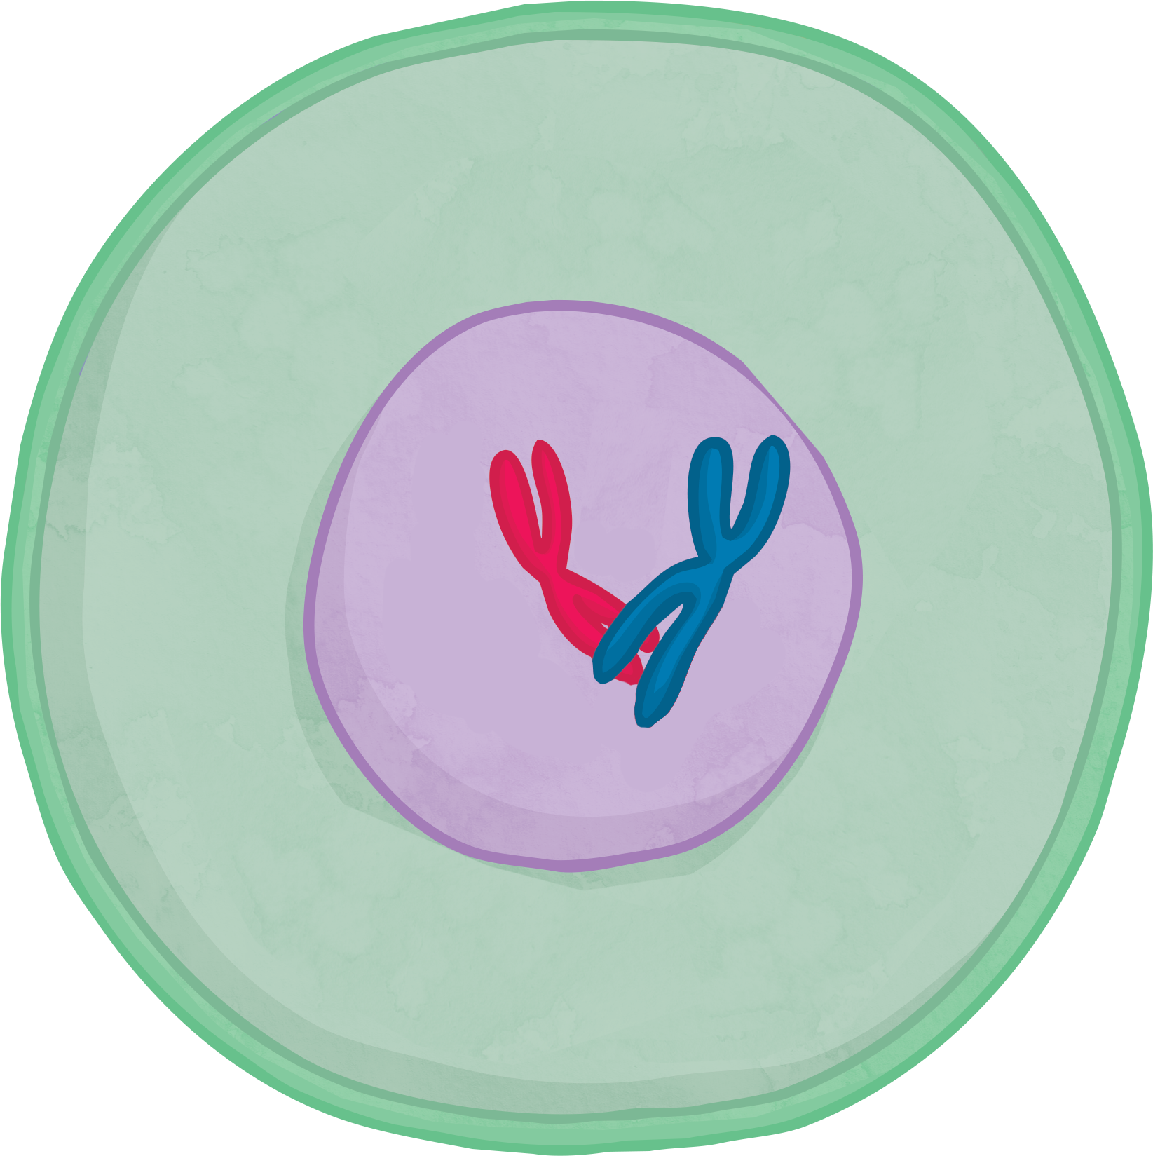
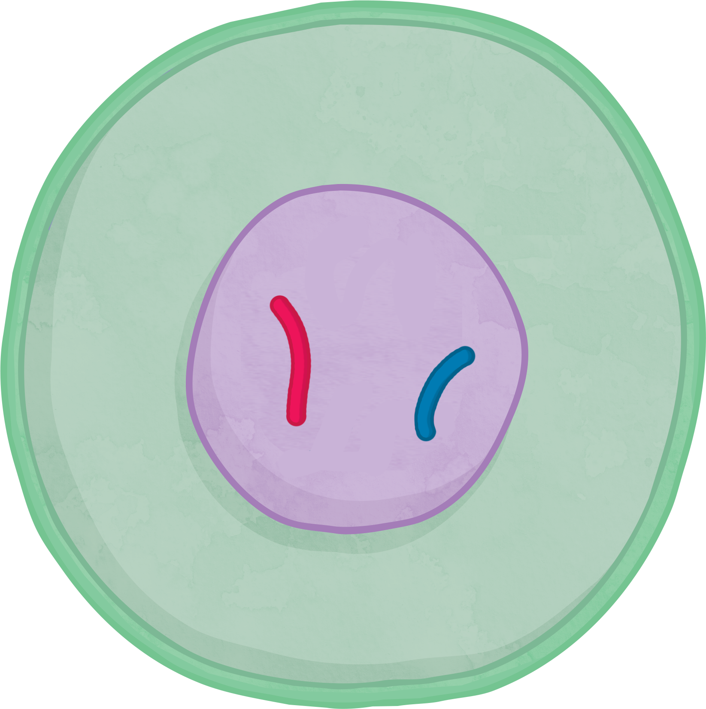
Mitosis vs Meiosis

Slide 15

Mitosis vs Meiosis
Rearrange these statements to show which describe mitosis and which describe meiosis.
Produces four daughter cells.
The cell divides once.
Daughter cells are not genetically identical.
Produces gametes.
The chromosome number of the daughter cells is the same as the parent cells.
The cell divides twice.
Produces two daughter cells.
Daughter cells are genetically identical.
The chromosome number is reduced by half.
Used for growth and repair, and asexual reproduction.

Slide 16
Mitosis vs Meiosis Answers
Mitosis
Meiosis
Produces two daughter cells.
Daughter cells are genetically identical.
The cell divides once.
The chromosome number of the daughter cells is the same as the parent cells.
Used for growth and repair, and asexual reproduction.
Produces four daughter cells.
Daughter cells are not genetically identical.
The cell divides twice.
The chromosome number is reduced by half.
Produces gametes.

Slide 17

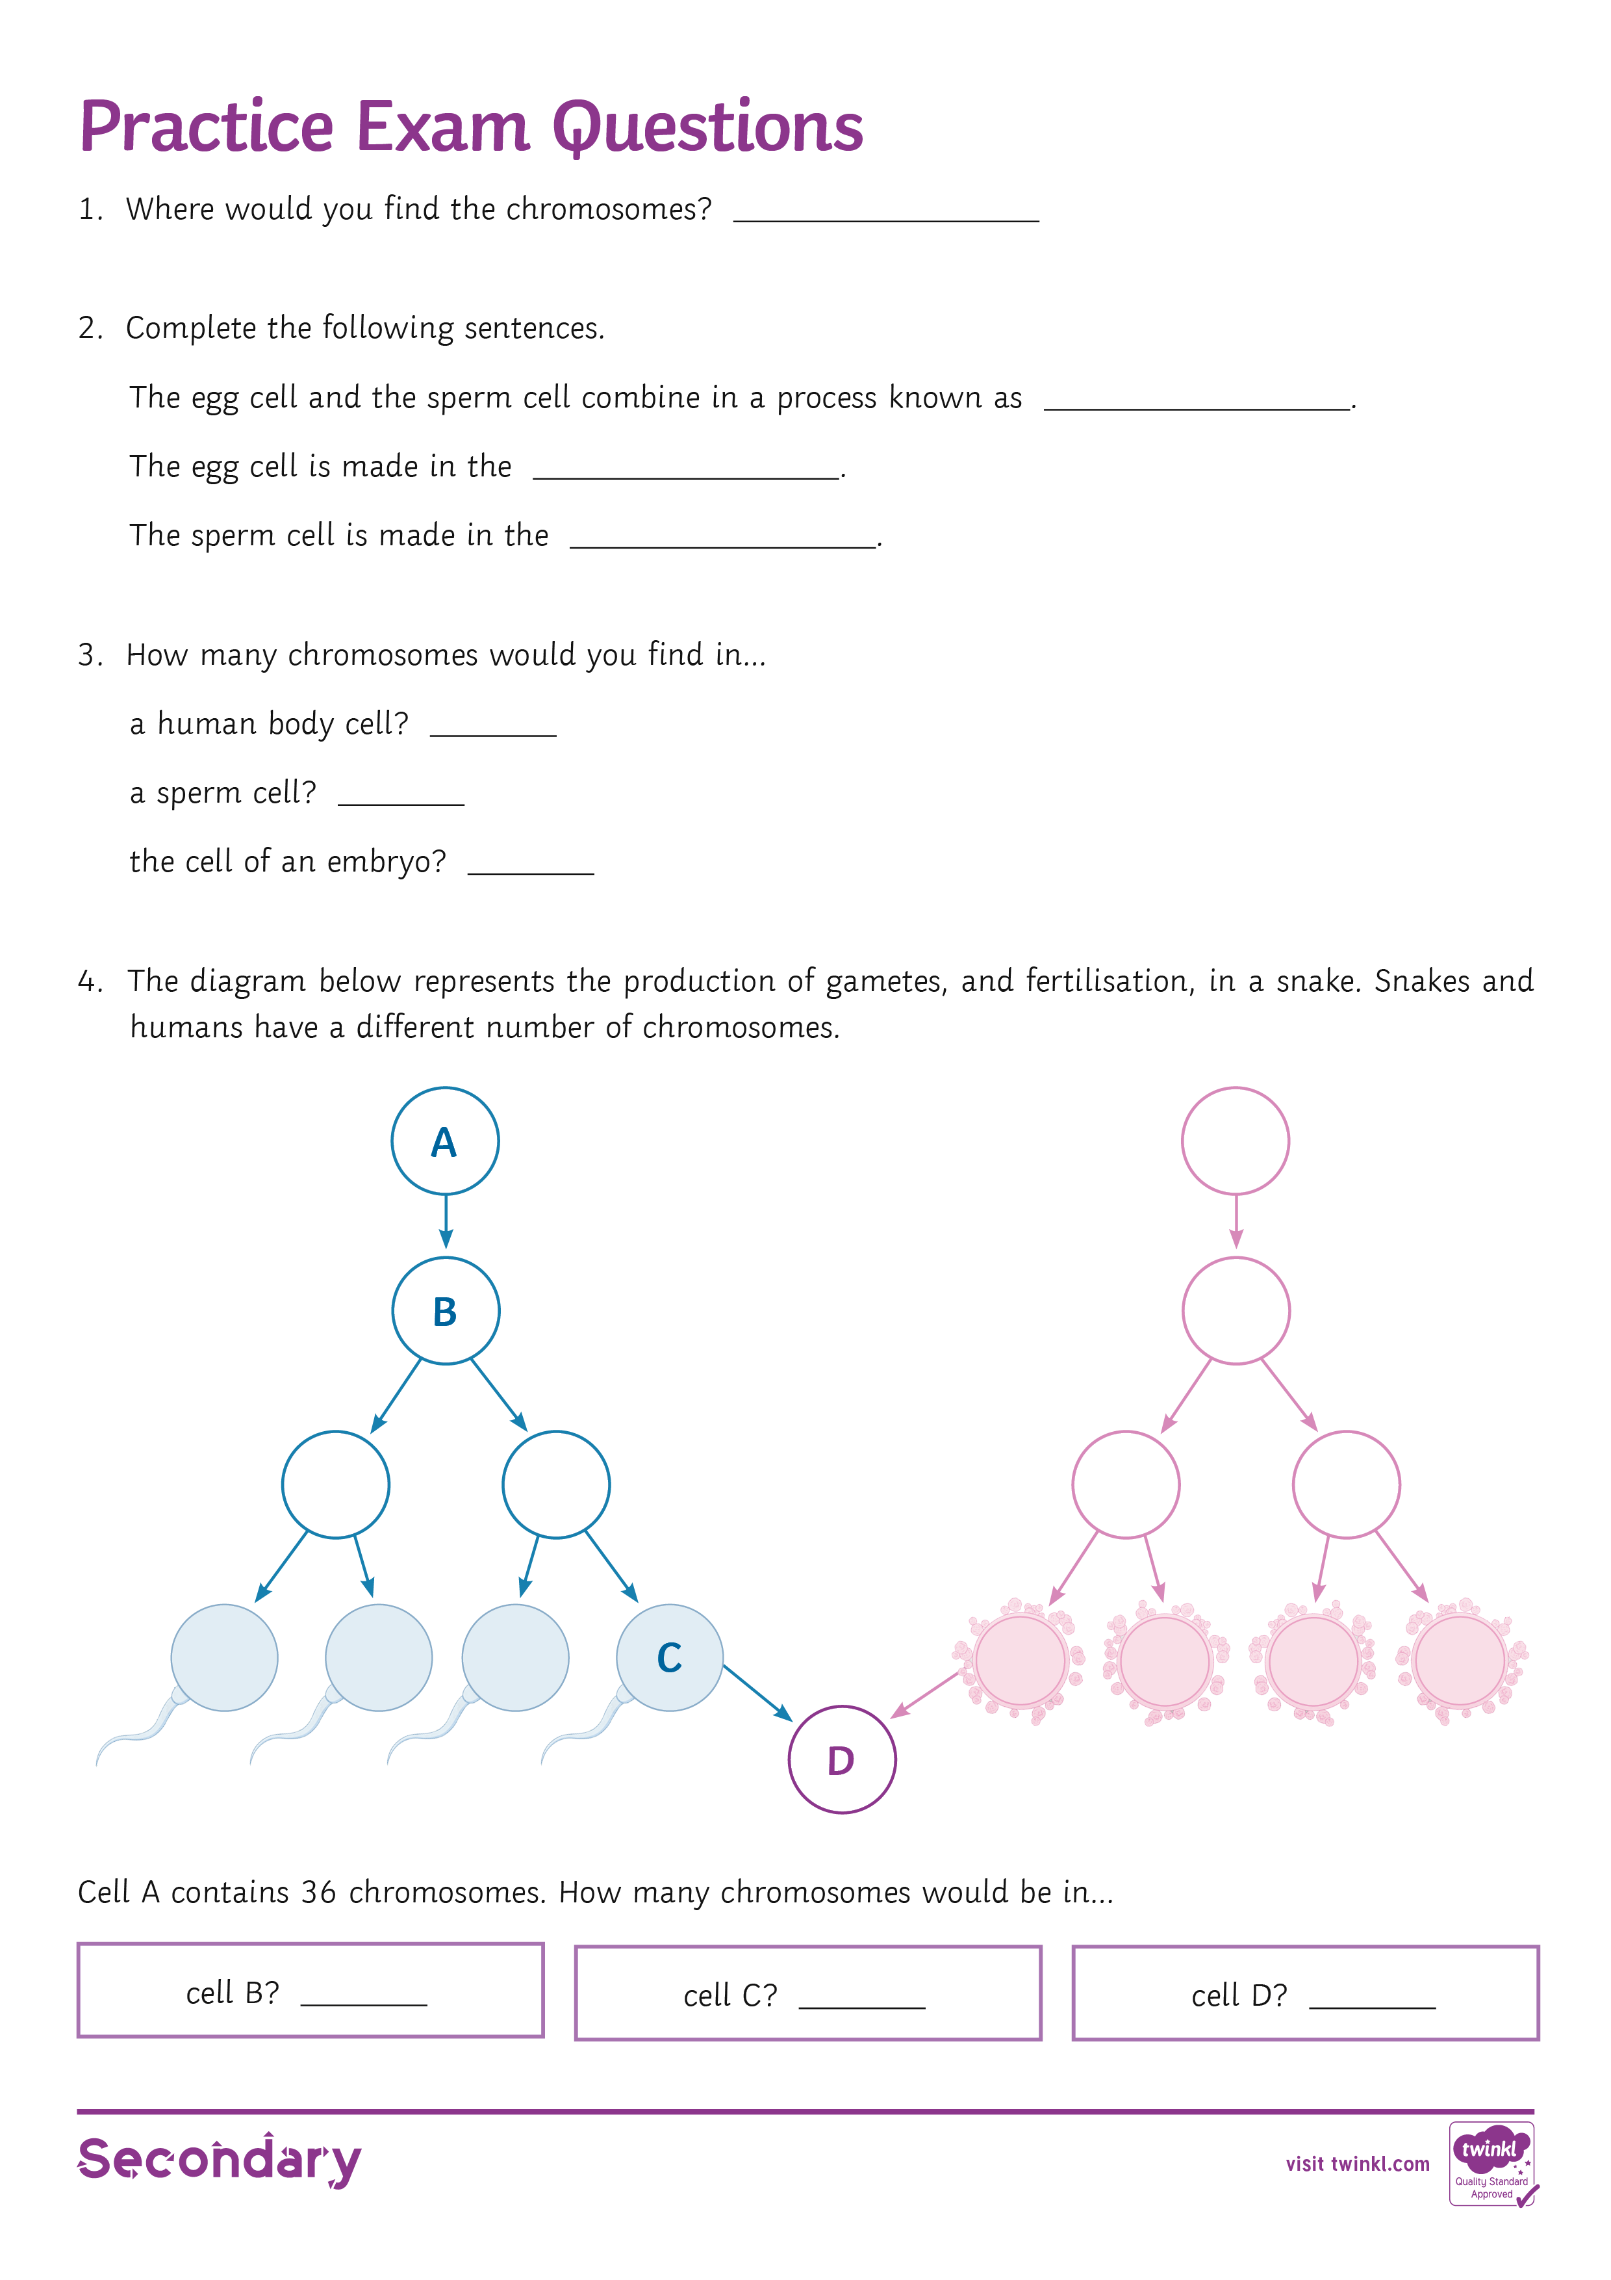
Practice Exam Questions
Key Terms
compare
You need to describe the similarities and/or differences between things. Don’t just write about one.
You need to write something about x compared to y. In this question you make a statement about mitosis and then compare it with meiosis.
In compare questions you should use comparative words such as better, more than, less than, quicker, on the other hand etc. Your use of the correct scientific terms for each example will be important.

Slide 18

Meiosis or Mitosis?
Produces four daughter cells.

Slide 19
Meiosis or Mitosis?
The chromosome number
is reduced by half.

Slide 20
Meiosis or Mitosis?
Used for growth and repair,
and asexual reproduction.

Slide 21
Meiosis or Mitosis?
Daughter cells are not
genetically identical.

Slide 22
Meiosis or Mitosis?
The cell divides once.

Slide 23
Meiosis or Mitosis?
Produces two daughter cells.

Slide 24
Meiosis or Mitosis?
Produces gametes.

